Slide 1

ParkSmart
Capstone Project Phase A
25-1-R-5
Research of Pattern Recognition and Visualization Based on Personal Data for Support and Quality of Life Improvement for Parkinson's Patients.
Presented by:
Yuval Shekel
Noam Vallach
Supervison:
Dr. Julia Sheidin
Dr. Avital Shulner Tal

Slide 2
Our project
Parkinson's: A neurodegenerative disease with no cure
Personal patterns improve disease understanding
Integrating technology to analyze patient data
Presenting patterns through accessible and clear methods
Enhancing quality of life and treatment

Slide 3
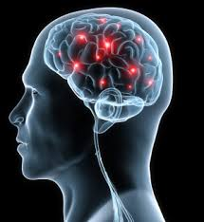
Parkinson's Disease
A neurodegenerative disease of the nervous system
Symptoms: tremor, rigidity, slow movements, sleep problems, depression
Caused by dopamine deficiency in the brain
Causes: combination of genetic and environmental factors

Slide 4
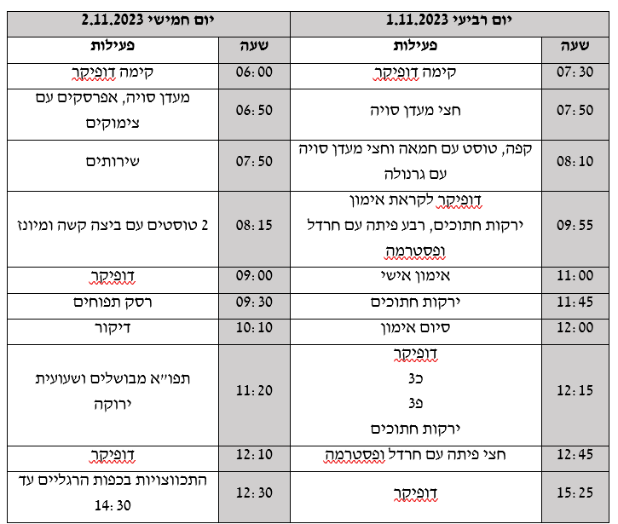
Collected Data
User-Centered Design approach – the process revolves around Michael’s needs and feedback
Data gathered in a previous project
Personal data on the patient's daily life
Sleep times, medications, diet, and physical activity
Daily symptoms and their frequency
Unstructured data with multiple variables collected over time

Slide 5
Data Pre-processing
Preparing data for advanced analysis tools
Converting data into a suitable format
A crucial step for accuracy and reliability

Slide 6
Research Questions
What patterns can be identified from the existing data, and how can they be classified as good or bad?
How can these patterns be presented to the user in a clear and accessible way?

Slide 7

Identifying Patterns
Helps find important relationships
Improves predictions and monitoring
Sub-group classification helps understand diseases
Machine learning techniques perform advanced analysis

Slide 8

Tools for Identifying Patterns
Weka: A machine learning tool
Weka's advantage: User-friendly graphical interface
SVM: Pattern recognition for regression and classification
SVM's advantage: Analysis of complex data

Slide 9

Tools for Presentation of patterns
Purpose: using Explainable AI to create understandable and transferred artificial intelligence
SHAP: Explains feature contributions to predictions
SHAP's advantage: Consistent, theory-based, for complex models
LIME: Approximates predictions with simple models
LIME’s advantage: Flexible, tailored explanations for predictions

Slide 10
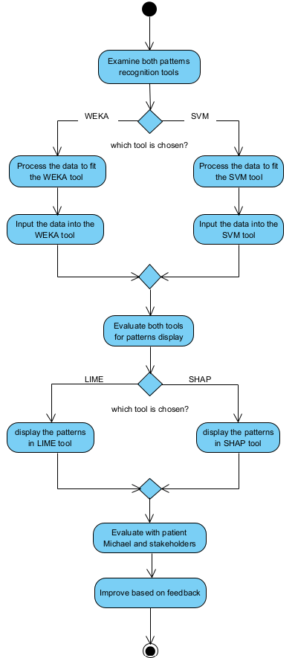
Work Process
Analysis of daily routines of patient
Use of technologies for pattern recognition
Presentation of patterns through XAI
User feedback for system improvement

Slide 11
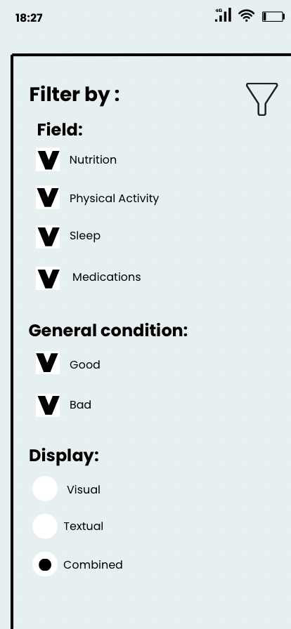
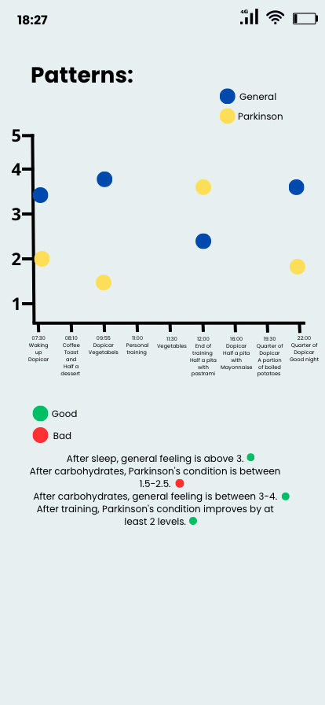
GUI

Slide 12

Expected Challenges
Use of advanced, complex tools
Integration between different tools
Verification of the accuracy and utility of patterns

Slide 13

Evaluation Plan
Technical Evaluation - Checking tool suitability, functionality, and pattern Identification
User Evaluation - Ensuring insights are useful and clear for Michael

Slide 14


Thank You!
Now it's time for questions! ☺

